Slide 1

Scala Meets GenAI

Slide 2
Build the Cool Stuff with LLM4S
Presenters: Rory Graves & Kannupriya Kalra
Event: London Scala User Group | August 13th, 2024
Notes:
Instead of starting with introductions, we're going to jump right in. Can you build the coolest GenAI apps in Scala? Let's find out with a game!

Slide 3
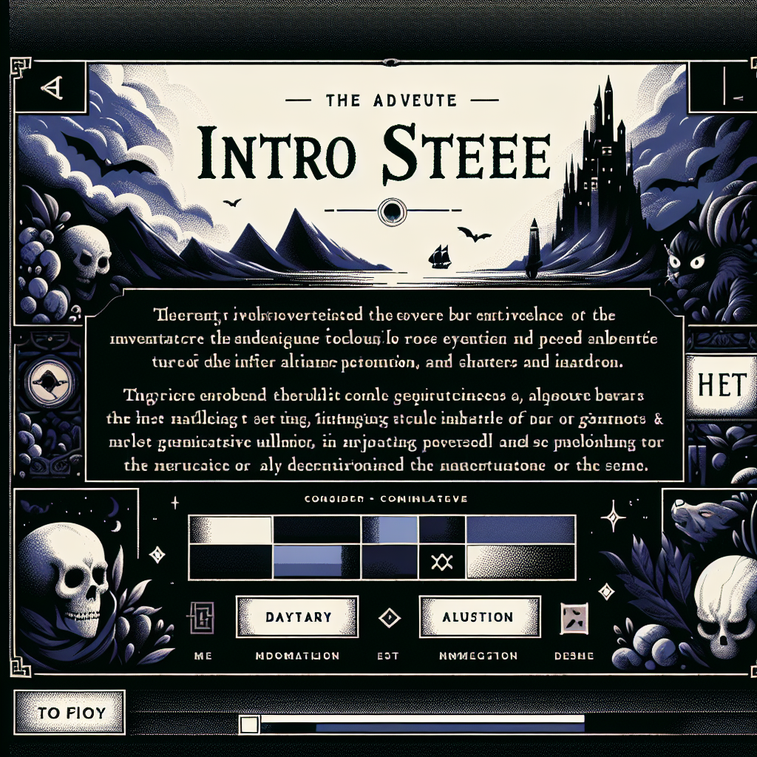
Let's Play SZork!

Slide 4
100% Scala-Powered AI Adventure
Features:
Real-time story generation
Dynamic image creation
Adaptive music
Voice input support
Notes:
This is SZork - a fully AI-powered text adventure game. Everything you're about to see - the story, the images, the music - is generated in real-time by AI, orchestrated entirely through Scala and LLM4S.

Slide 5
VOTE NOW: What kind of adventure?
Interactive Adventure Theme Selection
Notes:
Let's make this interactive! Show of hands - which adventure theme should we play? [Count votes] Great, looks like [winner] wins!

Slide 6




VOTE: Pick the art style!
Pixel Art
Illustration
Oil Painting
Comic Book
Notes:
And now for the visual style - which one appeals to you? [Take vote] Perfect! Let's start the game with [chosen theme] in [chosen style].

Slide 7
AI Services Orchestra
Network Architecture with Central LLM4S/Scala Node

Slide 8
Real-Time Integration
LLM4S (Scala) ─┬─→ OpenAI GPT-4 (Story)
├─→ DALL-E 3 (Images)
├─→ Whisper (Speech-to-Text)
├─→ TTS (Narration)
└─→ Suno AI (Music)
API Calls Per Turn:
Story generation: 2-3 calls
Image creation: 1 call
Music generation: 1 call
Total latency: ~5-8 seconds
Notes:
[Open browser dev tools] Look at this - every aspect is powered by different AI services, all orchestrated through LLM4S. No Python, no JavaScript AI libraries - pure Scala managing this complex multi-modal experience.

Slide 9


Meet the Founders
Rory Graves
Kannupriya Kalra
Co-founder & CTO
Co-founder & CEO
• 30+ years building tools
• Scala compiler contributor
• AI/ML research & mentorship
• GSoC admin Scala Center
• 10+ years functional programming
• International speaker
Our Journey:
2021: Project inception • 2022: Open source release
2023: Google Summer of Code • 2024: Production ready
Notes:
We're both original founders of LLM4S. We built it because we needed GenAI in our production Scala systems, and Python wasn't cutting it for enterprise scale.

Slide 10
Why We Built LLM4S
Page Layout: Timeline

Slide 11
The Problem:
🐍 Python dominance in AI/ML
📊 Enterprise needs type safety
⚡ Production requirements
🔧 Integration challenges

Slide 12

The Solution:
✅ Pure Scala implementation
✅ Type-safe AI operations
✅ Production-ready features
✅ Seamless JVM integration
Growth: 98 ⭐ | 15+ Contributors
Notes:
We needed GenAI in our production Scala systems. Python libraries were great for prototypes but lacked the type safety and JVM integration we needed at scale.

Slide 13
Community-Driven Development
GSoC Contributions & Community Growth

Slide 14
GSoC 2023 Contributions
📚 Embedding support system
🔌 MCP (Model Context Protocol) integration
🧪 Enhanced testing framework
📖 Comprehensive documentation
🎯 New sample applications
Community Growth:
Students: 5 GSoC participants
New features: 12 major additions
Code contributions: 2,500+ commits
Documentation: 100+ pages
Notes:
Google Summer of Code transformed LLM4S from a useful tool to a comprehensive framework. Students added embedding support, MCP integration, and much more.

Slide 15
Beyond Generation: Image Understanding
Page Layout: Comparison
Visual Specification:
• Left: Input image/screenshot
• Right: AI analysis output
• Code snippet at bottom

Slide 16
Input: Screenshot or uploaded image
Upload or capture screenshots of your content
Supported formats: PNG, JPG, JPEG
Drag and drop or click to browse files

Slide 17
Output: Structured Analysis
val analysis = client.analyzeImage(
imageFile = "screenshot.png",
prompt = "Describe this UI and suggest improvements"
)
// Returns detailed component analysis
Use Cases:
📱 UI/UX analysis
🔍 Document processing
♿ Accessibility checking
🛡️ Content moderation
Notes:
Not just generation - understanding too. Upload any image and get structured analysis. Perfect for automated testing, documentation, or accessibility compliance.

Slide 18
Immutable Agent State Management
State Flow: Initialize → History → LLM → Tools → Update → Return
Notes:
Back to SZork - how does the game agent work? It's all about immutable state management. Every action creates a new state, maintaining complete history.

Slide 19
Extensible Tool System
Tool-Driven Agent Architecture

Slide 20
PDF & Document Intelligence
Advanced PDF Processing & Semantic Search with Scala
Notes:
Same agent pattern, different tools. Process PDFs, extract structured data, perform semantic search - all with type-safe Scala code.

Slide 21
The Power of Type Safety
Side-by-side code comparison with type safety highlights and performance metrics

Slide 22
Scala:
def generateStory(theme: Theme, style: ArtStyle): Either[LLMError, Story] =
// Compile-time safety

Slide 23
Python:
def generate_story(theme, style):

Slide 24
Runtime errors possible
Benefits:
• ✅ Compile-time error prevention
• ✅ Immutable data structures
• ✅ Concurrent processing
• ✅ JVM ecosystem access
Performance: 45ms response time
Notes:
Why Scala matters - type safety prevents runtime errors that plague Python implementations. Plus immutability and JVM performance at scale.

Slide 25
Complete AI Toolkit
All demonstrated today in SZork!
Notes:
Everything on this list - we've shown you today through SZork and our demos. This is a complete toolkit for building AI applications in Scala.

Slide 26
Enterprise-Ready
Page Layout: content-with-sidebar
Visual Specification:
• Main: Feature list with icons
• Sidebar: Architecture diagram

Slide 27
Multi-Provider Support:
OpenAI, Anthropic, Cohere
Local models (Ollama)
Switch with one line

Slide 28
Observability:
Langfuse integration
Distributed tracing
Cost tracking

Slide 29
Reliability:
Either[Error, Success] pattern
Retry mechanisms
Graceful degradation
Scale: 10+ production deployments
Notes:
This isn't just for demos - LLM4S is battle-tested in production. Multi-provider support, observability, error handling - everything you need for enterprise deployment.

Slide 30
Join the Movement
Professional Layout with Community Metrics

Slide 31
Community Stats:
GitHub: 98 ⭐
Contributors: 15+
Discord members: 500+
Monthly downloads: 10K+

Slide 32
Ecosystem:
Google Summer of Code
Corporate contributors
Academic research
Open source plugins
Get Involved:
💬 Discord: https://discord.gg/llm4s
🐙 GitHub: https://github.com/llm4s/llm4s
📚 Docs: https://docs.llm4s.io
Notes:
We're not alone - there's a growing community building amazing things with LLM4S. From GSoC students to enterprise teams, everyone's contributing.

Slide 33
Start Building Today
Page Layout: split-screen
Left: build.sbt configuration
Right: Simple example code

Slide 34
Add to build.sbt:
libraryDependencies +=
"com.llm4s" %% "llm4s-core" % "0.5.0"

Slide 35
Your First Agent:
// Quick Start with LLM4S
import org.llm4s.llmconnect.LLM
import org.llm4s.agent.Agent
// Initialize client (uses env vars)
val client = LLM.client()
// Create a simple agent
val agent = new Agent(client)
// Start conversation
val response = agent.chat(
"Tell me about Scala's type system"
)
// Type-safe response handling
response match {
case Right(message) =>
println(s"AI: ${message.content}")
case Left(error) =>
println(s"Error: ${error.message}")
}
Resources:
• 📁 Samples folder
• 🎮 SZork source code
• 📖 Documentation
• 💬 Discord support
Notes:
Getting started is simple - add one dependency, write a few lines of code. Check out the samples folder, explore SZork source, join our Discord for help.

Slide 36
You Can Build the Cool Stuff!
Large, bold call to action
QR codes for GitHub/Discord
Contact information
GitHub QR
Discord QR

Slide 37
Start Today:
🌟 Star us on GitHub: https://github.com/llm4s/llm4s
💬 Join Discord: https://discord.gg/llm4s
🤝 Contribute: We're looking for contributors!
📧 Contact: rory@llm4s.io | kannupriya@llm4s.io
Coming Soon:
Advanced RAG implementation
Streaming responses
More model providers
Enhanced MCP support
Notes:
You can build the cool stuff! Everything you saw today is open source. Star the repo, join our Discord, contribute code. Let's build the future of Scala + AI together.

Slide 38
Thank You!
Contact information and social media handles

Slide 39
Questions?
Rory Graves
🐦 @a_dev_musing
💼 linkedin.com/in/roryjgraves
Kannupriya Kalra
🐦 @KannupriyaKalra
💼 linkedin.com/in/kannupriyakalra
Project: github.com/llm4s/llm4s
Notes:
Thank you for joining us today! We have a few minutes for questions. Both of us are here to answer anything about LLM4S, SZork, or building AI applications in Scala.

Slide 40
Q&A
Prepared questions listed

Slide 41
Prepared Topics:
Technical Questions
Implementation & Deployment
• How does performance compare to Python?
• Can it work with local models?
• What about streaming responses?
• Rate limiting strategies?
• RAG implementation details?
• Production deployment tips?
• Contributing to LLM4S?
• Best practices & patterns?
Prepared backup questions ready for deeper technical discussions
Notes:
[Prepared backup questions if needed]
• "How does RAG performance compare to vector DBs?" - We support multiple backends...
• "Can it work with Llama?" - Yes, through Ollama integration...
• "Performance vs Python?" - JVM advantages at scale...

